Slide 1
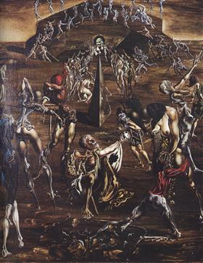
Salvador Dalí: XXth century surrealist painter
Life and Career
Resurrection Of The Flesh, 1945

Slide 2
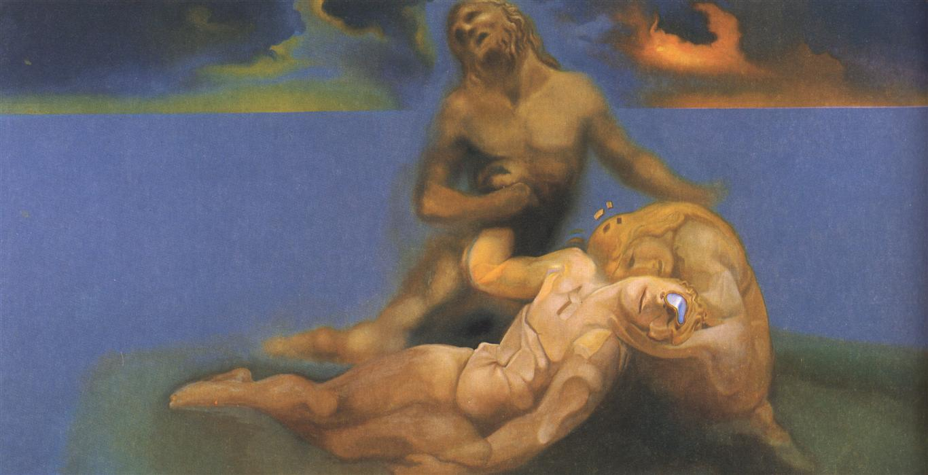
The famous Spanish surrealist painter, Salvador Dali had artistic repertoire that included sculpture, painting, photography, multimedia work, and collaborations with other artists, most notably independent surrealist films.
A Soft Watch Put In The Appropriate Place To Cause A Young Ephebe To Die And Be Resuscitated, 1979

Slide 3
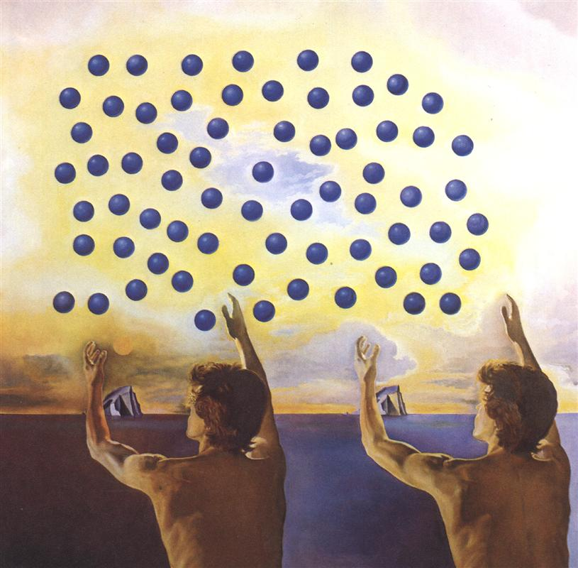
He was born on 11 May 1904 in Figueres, Catalonia, Spain. Dali was born in a quasi-surreal existence. His brother, also named Salvador, died as a toddler, nine months before Dali’s birth. His parents told him he was the reincarnation of his older brother, which he also came to believe.
The Harmony Of The Spheres, 1978

Slide 4
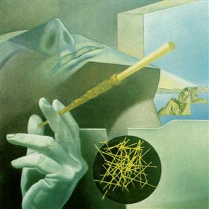
The Sleeping Smoker, 1972
As a child, Dali attended drawing school, and by the age of thirteen, Dali’s father was arranging exhibitions of his charcoal drawings. In 1922, Dali went to study at the School of Fine Arts in San Fernando, where he was known as a bit of a dandy, wearing long hair and sideburns, and stockings with knee breeches in the style of 19th century aesthetes.

Slide 5
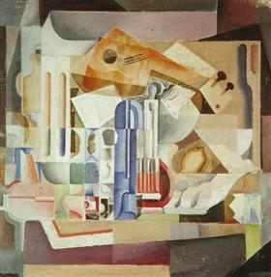
Crystalline Still Life, 1923
During his stay at the academy, Dali tried his hand in cubism and dada. But his stay was short lived, after he was expelled a few weeks before final exams, for stating that no one in the school was qualified enough to examine him. After his expulsion, he traveled to Paris, where he met Pablo Picasso and Joan Miro, who heavily influenced his painting styles.

Slide 6
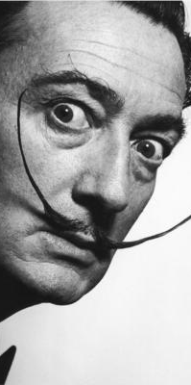
Salvador Dali, portait
From impressionism to renaissance works, he combined all elements into single compositions, raising interesting critiques from art critics, who were unsure as how to received his works. Always a dandy, Dali grew a large moustache, which was a trademark of his appearance for the rest of his life.

Slide 7
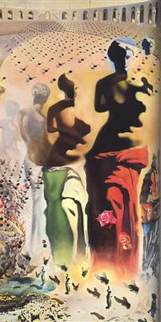
Hallucinogenic Toreador, 1970
In 1929, Dali began a relationship with the woman who would later become his wife, Gala. His father disapproved, and saw his connection with surrealism as a demoralizing influence on his son. Upon hearing reports that Dali had created a work with an inscription insulting his mother, who had died eight years earlier of breast cancer, the elder Dali disowned his son, telling him never to return home.

Slide 8
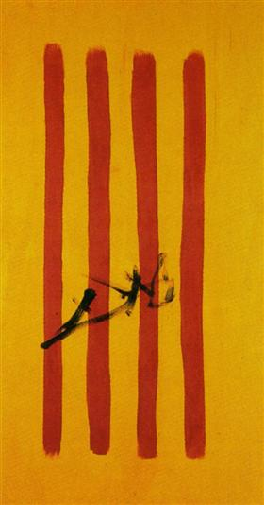
The Dalinian Senyera Catalonian National Flag, 1970
Dali spent the middle and late years of his life between the United States and his beloved Catalonia, Spain, collaborating with other artists, canoodling with social elites, and creating many stories for the newspapers. After his wife’s death in 1982, Dali lost much of his will to live, and purposely dehydrated himself almost to the point of death.

Slide 9
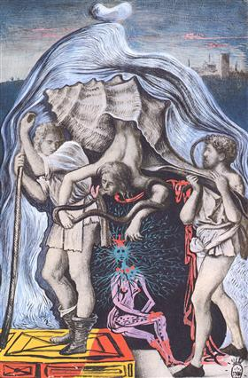
Metamorphosis Of The Five Allergies Of Giovanni Bellini, 1937
There was also a mysterious fire in his apartment in 1984, from which he was saved, but many thought was a suicide attempt. He died of heart failure five years later at the age of 84.

Slide 10
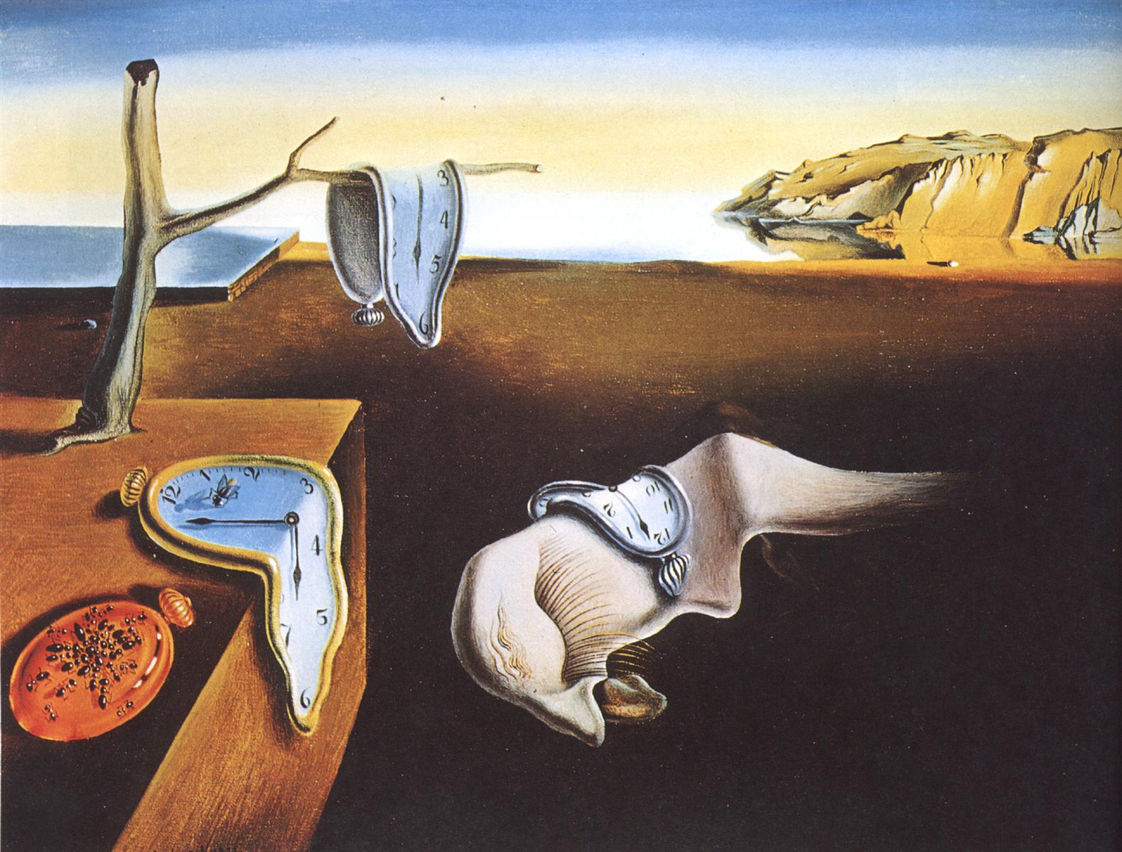
Dalí employed extensive symbolism in his work. For instance, the hallmark "melting watches" that first appear in The Persistence of Memory suggest Einstein's theory that time is relative and not fixed. The idea for clocks functioning symbolically in this way came to Dalí when he was staring at a runny piece of Camembert cheese on a hot August day.
The Persistence of Memory, 1931

Slide 11
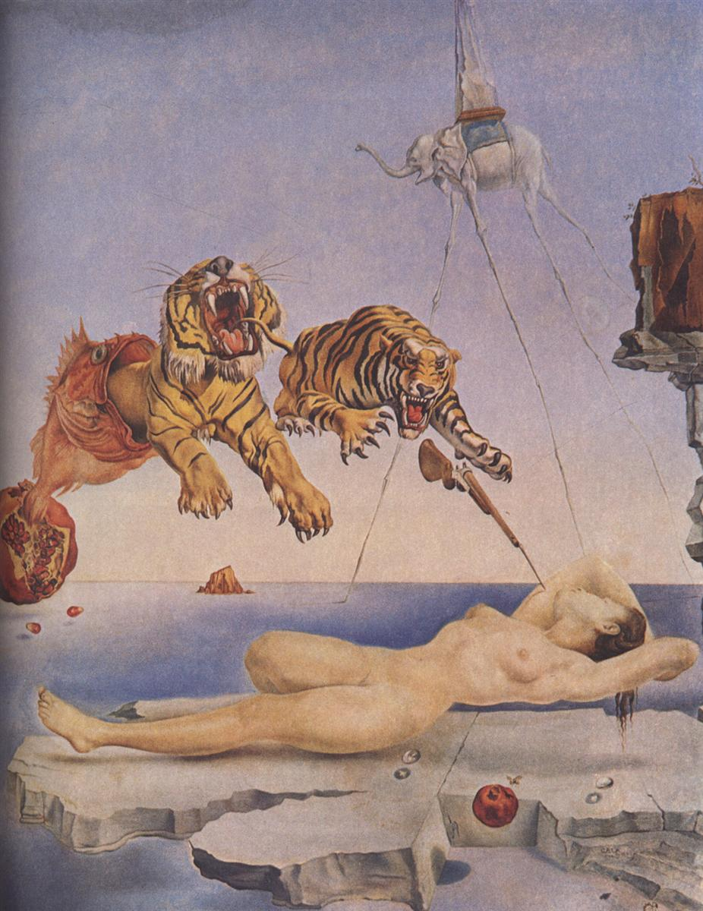
Dream Caused by the Flight of a Bee Around a Pomegranate a Second Before Awakening, 1944
The elephant is also a recurring image in Dalí's works. It appeared in his 1944 work Dream Caused by the Flight of a Bee Around a Pomegranate a Second Before Awakening. The elephants, inspired by Gian Lorenzo Bernini's sculpture base in Rome of an elephant carrying an ancient obelisk, are portrayed "with long, multijointed, almost invisible legs of desire" along with obelisks on their backs.

Slide 12
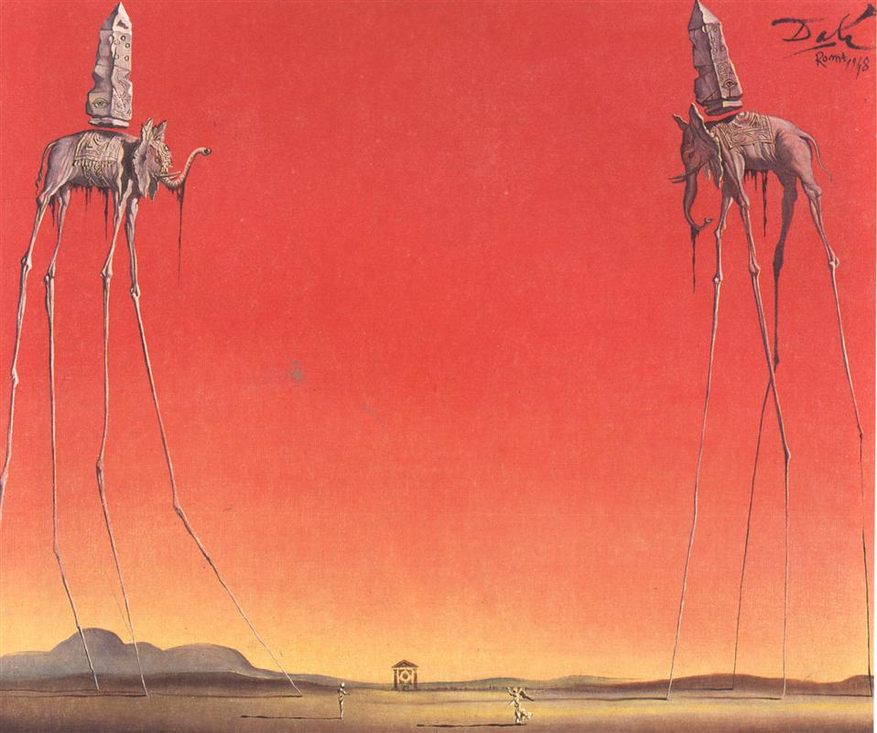
The Elephants, 1948
Coupled with the image of their brittle legs, these encumbrances, noted for their phallic overtones, create a sense of phantom reality. "The elephant is a distortion in space", one analysis explains, "its spindly legs contrasting the idea of weightlessness with structure."

Slide 13
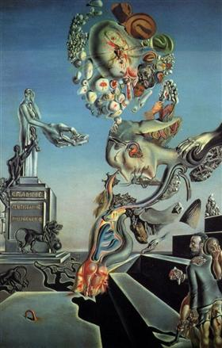
The Lugubrious Game, 1929
"I am painting pictures which make me die for joy, I am creating with an absolute naturalness, without the slightest aesthetic concern, I am making things that inspire me with a profound emotion and I am trying to paint them honestly." —Salvador Dalí, in Dawn Ades, Dalí and Surrealism.

Slide 14
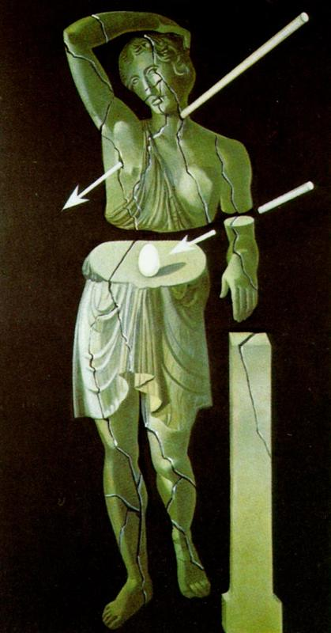
Woman With Egg And Arrows, 1978
The egg is another common Dalíesque image. He connects the egg to the prenatal and intrauterine, thus using it to symbolize hope and love; it appears in The Great Masturbator and The Metamorphosis of Narcissus. The Metamorphosis of Narcissus also symbolized death and petrification.

Slide 15
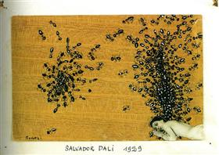
The Ants, 1929
Various other animals appear throughout his work as well: ants point to death, decay, and immense sexual desire; the snail is connected to the human head (he saw a snail on a bicycle outside Freud's house when he first met Sigmund Freud); and locusts are a symbol of waste and fear.

Slide 16
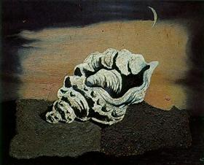
Shell, 1928
Both Dalí and his father enjoyed eating sea urchins, freshly caught in the sea near Cadaqués. The radial symmetry of the sea urchin fascinated Dalí, and he adapted its form to many art works. Other foods also appear throughout his work.

Slide 17
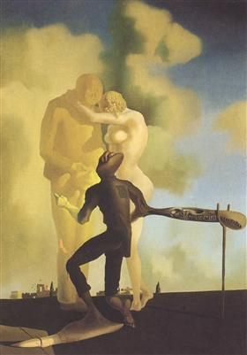
Meditation On The Harp, 1934
References to Dalí in the context of science are made in terms of his fascination with the paradigm shift that accompanied the birth of quantum mechanics in the twentieth century.

Slide 18
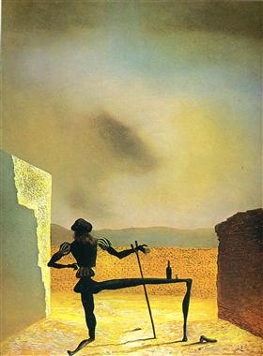
The Ghost Of Vermeer Van Delft Which Can Be Used As A Table, 1934
Inspired by Werner Heisenberg's uncertainty principle, in 1958 he wrote in his "Anti-Matter Manifesto": "In the Surrealist period, I wanted to create the iconography of the interior world and the world of the marvelous, of my father Freud. Today, the exterior world and that of physics has transcended the one of psychology. My father today is Dr. Heisenberg."

Slide 19
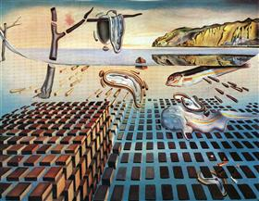
The Disintegration of the Persistence of Memory, 1954
In this respect, The Disintegration of the Persistence of Memory, which appeared in 1954, in harking back to The Persistence of Memory and in portraying that painting in fragmentation and disintegration, summarizes Dalí's acknowledgment of the new science.

Slide 20
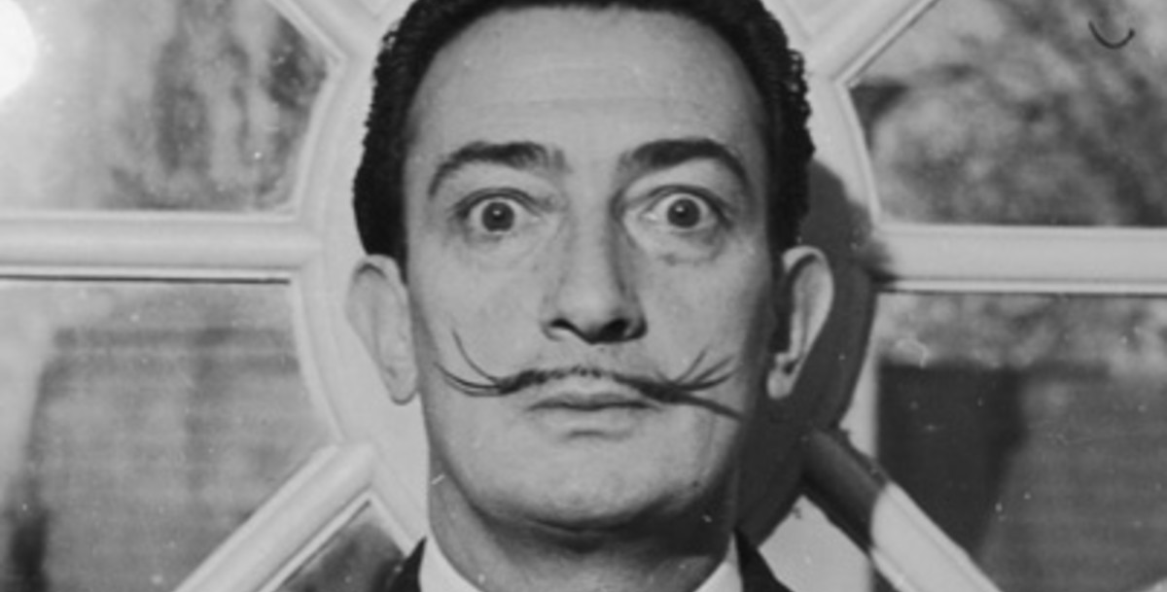
THE END

